Slide 1
Experiment result tracing
In working

Slide 2
Case5
Gender/m
Glass/y
Paper
Text Accuracy: 151.5 words/min
Image Distinguish: 100%
Ipad
Text Accuracy: 143 words/min
Image Distinguish: 100%

Slide 3
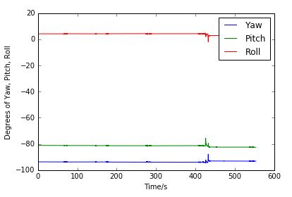
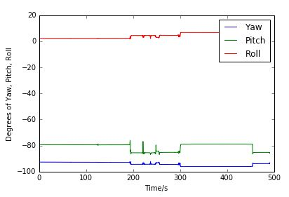
Case5
Gender/m
Glass/y
Paper
Text Accuracy: 151.5 words/min
Image Distinguish: 100%
Ipad
Text Accuracy: 143 words/min
Image Distinguish: 100%

Slide 4
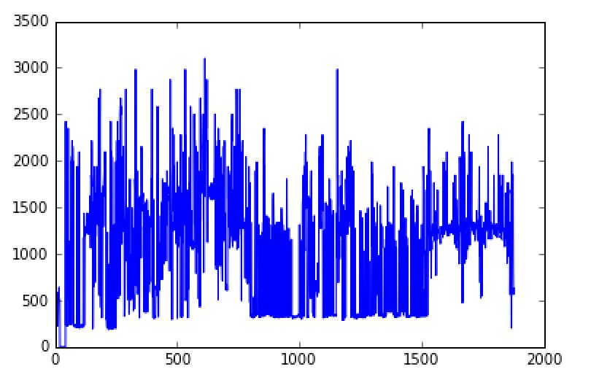
Case5
Gender/m
Glass/y
2017-04-28 11:56:17 259,46 61.1940298507
2017-04-28 11:56:18 268,76 488.095238095
2017-04-28 11:56:18 269,77 512.5
2017-04-28 11:56:18 271,77 512.5
2017-04-28 11:56:18 165,268 500.0
2017-04-28 11:56:18 204,393 301.470588235
2017-04-28 11:56:18 290,180 488.095238095
2017-04-28 11:56:18 202,386 250.0
2017-04-28 11:56:19 270,78 525.641025641
2017-04-28 11:56:19 272,77 525.641025641
2017-04-28 11:56:19 331,348 225.274725275
2017-04-28 11:56:20 30,118 427.083333333
2017-04-28 11:56:20 311,194 539.473684211
2017-04-28 11:56:20 318,199 585.714285714
2017-04-28 11:56:22 271,76 512.5
2017-04-28 11:56:23 311,201 640.625
2017-04-28 11:56:23 310,199 512.5
2017-04-28 11:56:23 311,198 512.5
2017-04-28 11:56:23 311,198 512.5
2017-04-28 12:13:51 125,5 0.0
2017-04-28 12:13:51 148,134 0.0
2017-04-28 12:13:51 130,6 0.0

Slide 5
Reorganize the data structure flow
Input accuracy
text1
text2
Average score
Basic information
Paper test test time for each
image3
image4
Average score
image5
image6
Visualization Model
text1
text2
Average score
Control data collected from GUI
Ipad test time for each
image3
image4
Average score
image5
image6
Facial data
Motion data
Solar data
Total time
Average by minute
Average by minute

Slide 6
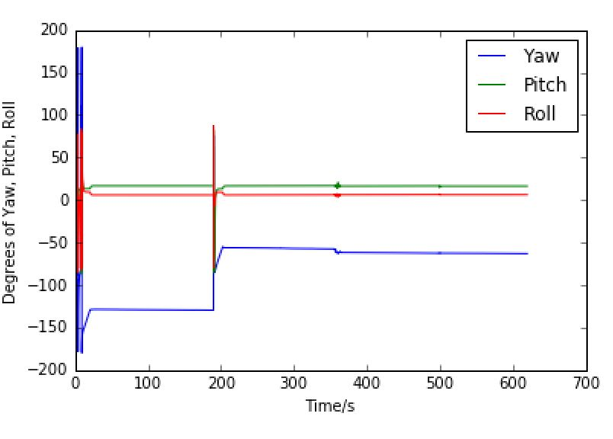
Case6
Gender/F
Glass/N
Paper
Text Accuracy: 144.5 words/min
Image Distinguish: 57%
Ipad
Text Accuracy: 159 words/min
Image Distinguish: 50%

Slide 7
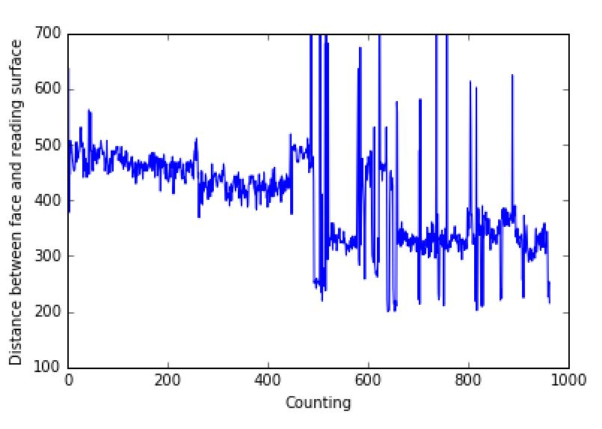
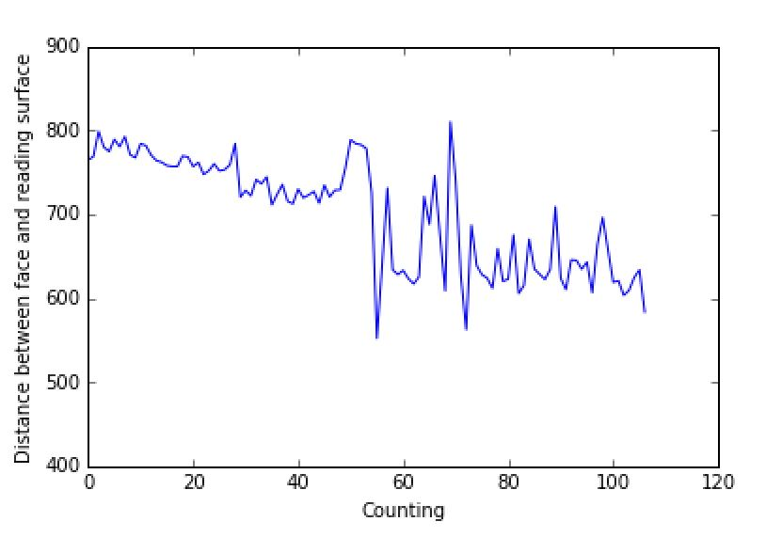
Facial analysis improvement
Gender/F
Glass/N
Distance analysis: Remove number > 3rd quantile

Slide 8


Facial analysis improvement
Gender/F
Glass/N
450
Camera: 640*480
How to normalize position?
Reverse relationship
0
600

Slide 9
Facial analysis improvement
Gender/F
Glass/N
450
Camera: 640*480
How to normalize position?
Reverse relationship
0
600

Slide 10
Trends update

